Slide 1
Partner Leadership Development Series:
Creating a Press Strategy
Presented by Erin Hershkowitz,
Media Relations Manager, Americas

Slide 2
Agenda
Introduction: why is this important?
Establishing good relationships with the press
Ground rules of a press interview
Conflict checks and press policies
Preparing for media interviews
Managing potentially “negative” press and challenging questions
What good media results look like
Leverage your press coverage on social media
The global media relations team

Slide 3

The importance of building a media presence
Your practice
  Providing the right press with information on your work combined with insightful and intelligent comments will get your name out to your target audience as a thought leader in your specific practice/sector
The Firm

Slide 4
Establishing good relationships with the press
Why is this important?
  Positive media coverage
  Placing positive stories that we want in the public sphere
  Accuracy and more control over messages
    Soften/shape negative stories or comments we don’t want in the public sphere
  In the end the right coverage can result in lead generation!

Slide 5
Establishing a good relationship with the press
How do we accomplish this?
  Be a credible and reliable source
  Be honest and provide your knowledge
    It’s more valuable than spin
    You will have to back up what you say
  Make the commitment to meet with press
    Take the time for coffee, lunch, drinks

Slide 6
Ground rules of a press interview
On the record: anything you say can be used and attributed to you
Off the record: no comments you make will be attributed to you/the Firm or shared with others
On background: your comments may not be attributed to you/the Firm
  Comments are used as background information to help media frame an article and/or used as a blind quote
      …“says an international trade lawyer”
      …“said a tax attorney”
  *However, if you don’t want to see it in print, don’t say it!

Slide 7
Conflict checks and press policies
It is the press office’s job to create and vet media opportunities and clear them of potential client conflicts
Always send media inquiries to someone on the media relations team
Our policies:
  The press office must seek permission from the lead relationship partner to be quoted in an article that mentions clients
  You cannot discuss clients and client matters/deals without the client’s permission to do so
  We cannot confirm our involvement in a client matter with the press without the client’s permission to do so

Slide 8
Preparing for media interviews
Understand the Audience
Be mindful that when you are speaking with the media, you are talking to the end reader – not the reporter. Is this a newswire that other reporters will read? A columnist reaching a business audience? A reporter for a daily newspaper who is writing for the general public? It is important to understand how to tell your story depending upon how the news will be consumed.
Know the Interview Ground Rules
Before you begin an interview, be clear on whether the interview is for attribution, off-the-record or on-background. Communicate that while off-the-record interviews can be helpful to build relationships, one is never truly off-the-record. In other words, do not say anything you do not want to see printed.

Slide 9
Preparing for media interviews
Develop Messages
  You should not participate blindly in media interviews. Take time to think about what you want to say in 3-4 short messages. Say your main key messages up front and then provide the supporting information (inverted pyramid) -- this is the opposite of how we speak in a regular conversation.
Read up on the Reporter
We will arm you with a briefing document before an interview. Take the time to read it and review recent media coverage by the reporter and media outlet.
Avoid Jargon
You may assume that a reporter would understand in great detail the topic at hand, but this is not always the case. To avoid confusion, do not use jargon and speak in simple terms.

Slide 10
Preparing for media interviews
Do Not Comment on Competition
It is inappropriate to comment publicly on other law firms, their work/clients, or how our Firm may compare in terms of offerings or in any regard.
Be Clear on Quote Review
In some instances interviews may have been arranged on a “checks quotes basis.” Meaning, the spokesperson and/or Media Relations Manager will be allowed to review any quotes before they are published. Be clear as to what guidelines are in place in this regard and when given the opportunity. Many times a quote review only means that you can review them for accuracy. Also, be sure to take the time to review the quotes carefully.

Slide 11
Preparing for media interviews
Avoid Mentioning Competing Media Outlets
Reporters like to think you are providing them with news. Avoid sharing the fact you have spoken to other reporters on the same topic or often read competing publications.
Take Advantage of the Bonus Question
Often at the end of an interview a reporter will ask if there is anything else you would like to add. This “bonus question” is an excellent opportunity to quickly sum up and reiterate your messages.

Slide 12
Preparing for media interviews
Do Not Guess
If you are faced with questions you cannot answer, you shouldn’t. There is no need to say “no comment” as you can simply note that they do not know the answer or will get back in touch.
No Commenting on the Business of the Firm
Do not comment or offer details pertaining to goings-on at the Firm. For example: revenues, hiring practices, reorganizations, unannounced office openings, etc.

Slide 13
Managing potentially “negative” press
You may occasionally be approached about a negative story. Here is how you should you handle it:
  Contact Media Relations to discuss
  We will circle up with the right partners and, possibly, the GC to find all the facts
  Based on what we find, we will determine the right way forward
Often we will decline comment; however, we may want to provide background
  This may include steering the story by ensuring the journalist includes other salient facts to soften the blow
  We will also work with you to create talking points/key messages you may want to use with clients or inside the Firm

Slide 14
Challenging Questions
To “bridge and flag” is to simply move away from a topic you do not wish to discuss and flag something you believe to be more important. For example, see the below fictional Q&A:
Q1: Deutsche Bank has raised a lot of questions about Basel III compliance and how it could affect dividend payouts. From a regulatory standpoint, what do you think about that?
A1: “I am not at liberty to discuss goings-on at any one specific company. But what is really important to know -- generally speaking -- is…”
Q2: What do you think about Smithfield, an “American Dream” story of sorts, being taken over by a Chinese conglomerate?
A2: “Specific companies aside, here are the two most important things readers need to take into consideration: 1) XXX, and 2) XXX.”

Slide 15
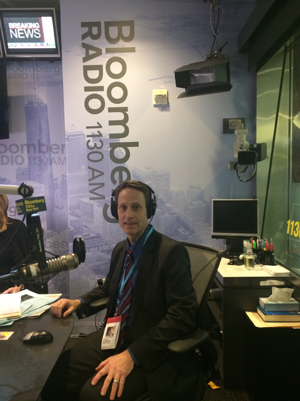
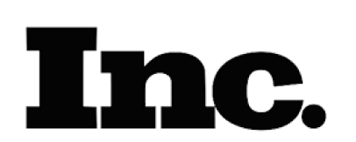
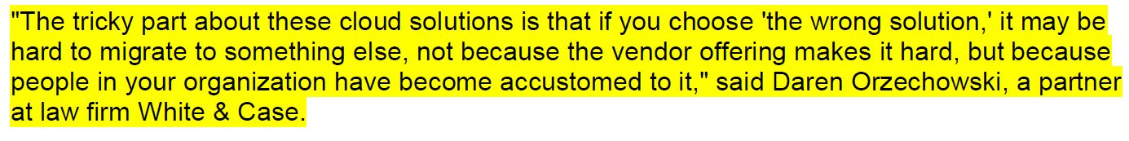

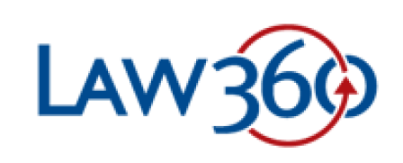
What good media results look like
3 Tips for Improving Your Business with Analytics
Swelling Docket Pushing Delaware Judges to Transfer Cases
5 Daily Habits Of Rainmakers & How They Can Work For You

Slide 16


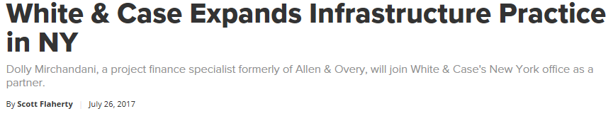
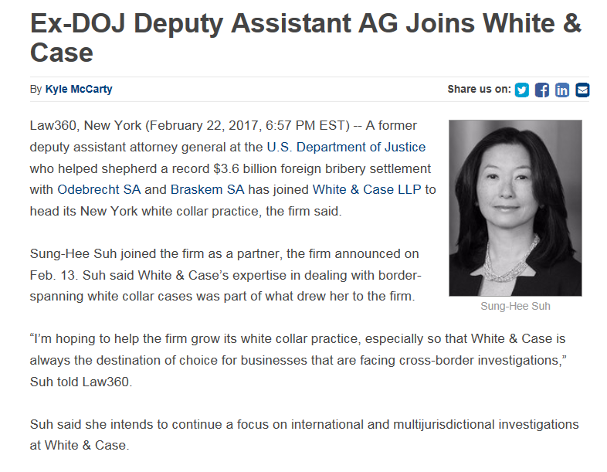
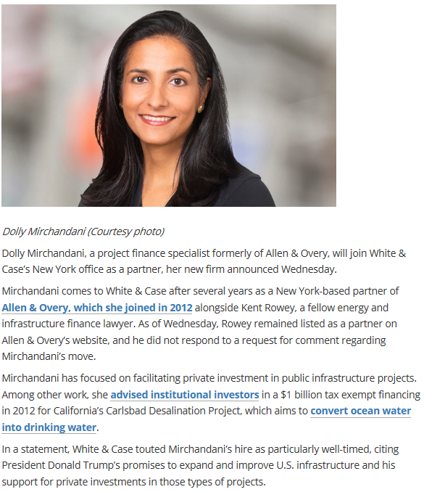
Announcements

Slide 17
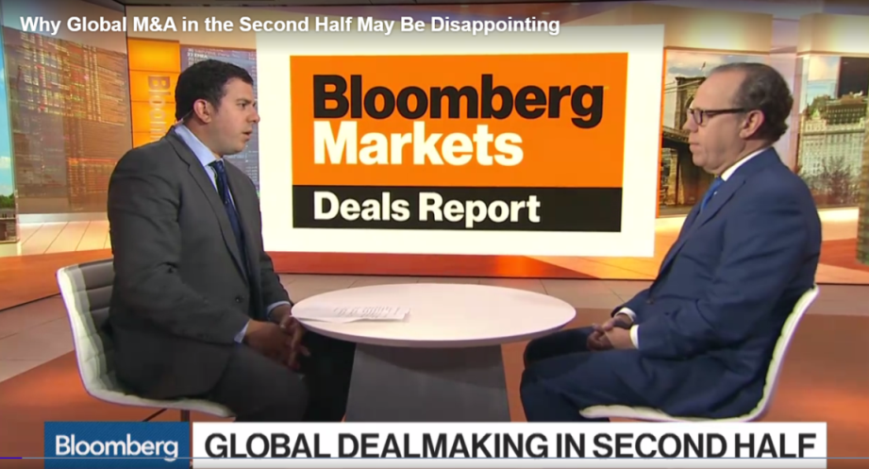
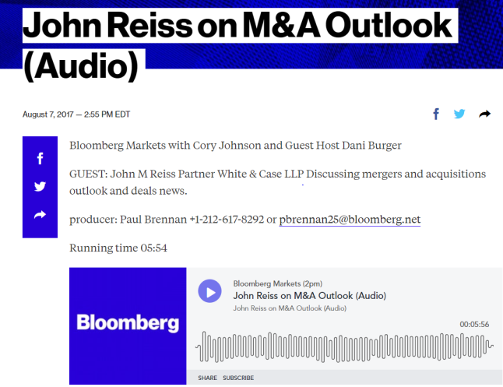
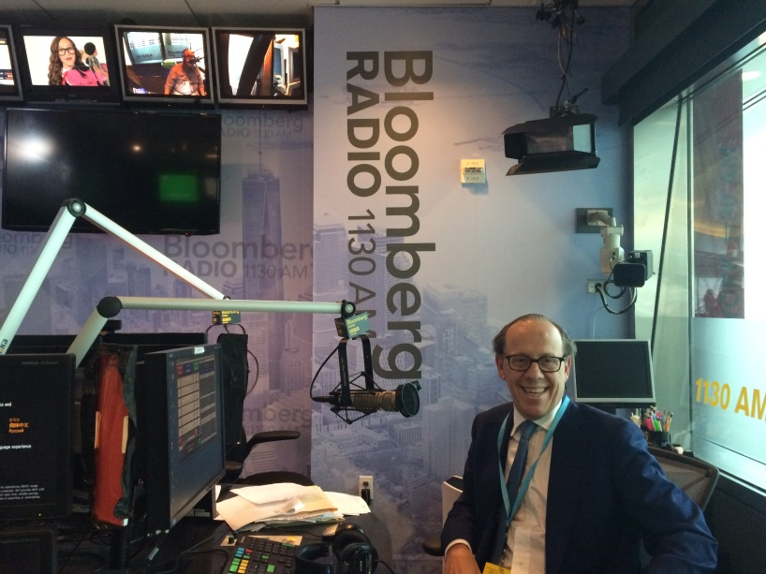


Thought leadership

Slide 18

Thought leadership
https://www.bloomberg.com/news/videos/2017-07-10/why-m-a-in-the-second-half-may-be-disappointing-video

Slide 19


Leverage your press coverage on social media
Post positive news coverage on LinkedIn and Twitter
Follow and tag relevant press and they might follow you back!
Use hashtags: #capmarkets #privateequity #internationallaw

Slide 20
The Media Relations Team
Mikki Mahan
Global Head of Communications
Justin Perras
Global Director of Media Relations
Erin Hershkowitz
Media Relations Manager, Americas
Luis Mocete
Senior Media Relations Manager, Americas
Andrew Newsham
Senior Media Relations Manager, EMEA
Charlotte Sansom
Senior Media Relations Manager, EMEA

Slide 21
Questions?

Slide 22
Thank you

